Slide 2



“I am just one person! What can I do to change anything?
Is it TRUE that ONE PERSON cannot make much difference in the way things are?

Slide 3
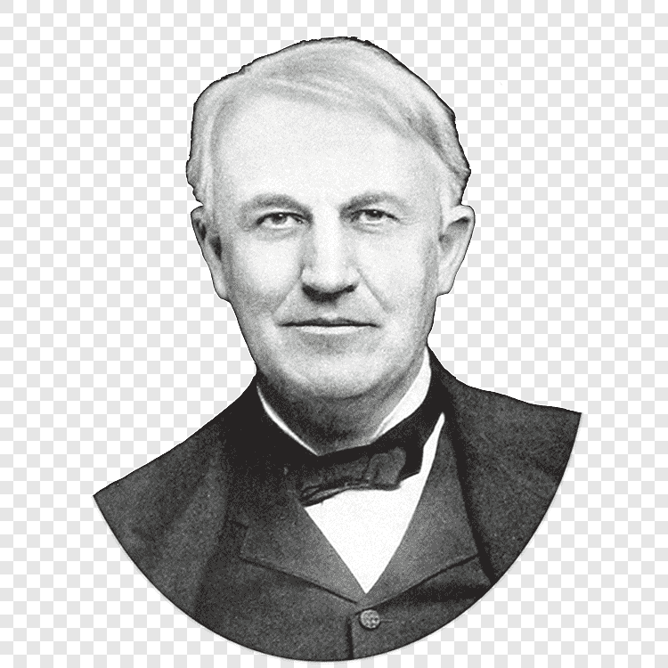
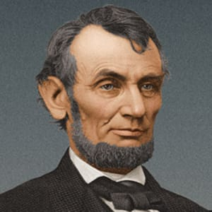

Some Of The Great Men Of Our History
Some NOT SO GREAT

Slide 4
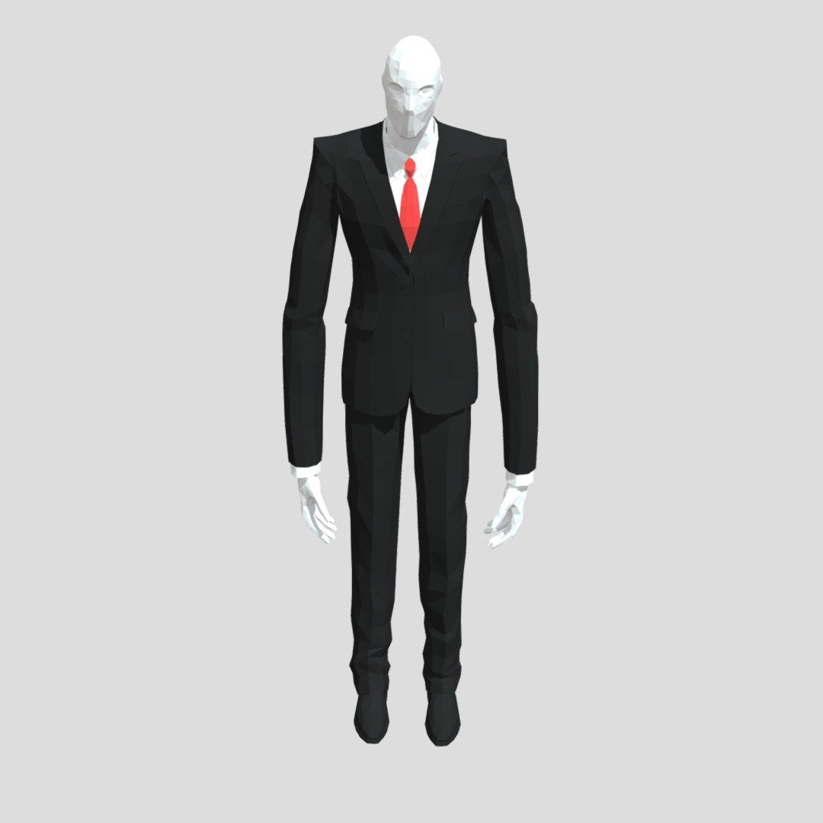
What Can One Good Man Do?

Slide 5
WHAT CAN ONE GOOD MAN DO?
Noah – Genesis 6:5-10 "every intent of the thoughts of man's heart was only evil continually"
ONE MAN – STANDING AGAINST THE WHOLE WORLD!
Joshua – Joshua 24:15 “as for ME and MY HOUSE, WE WILL SERVE THE LORD."
Joshua 24:24 “"THE LORD OUR GOD WE WILL SERVE, AND HIS VOICE WE WILL OBEY."
ONE GOOD MAN can do MUCH when he takes a stand WITH THE LORD!
John the Immerser – Matthew 3:7 "BROOD OF VIPERS! WHO HAS WARNED YOU TO FLEE FROM THE WRATH TO COME?"
Matthew 14:1-11 "It is not lawful for you to have her."
Matthew 11:11 “there has not risen one greater than John the Baptist;"
Paul – 2 Corinthians 11:24-28 "perils among FALSE BRETHREN"

Slide 6
Encouragement For Good Men Today
Proverbs 12:2 "A GOOD MAN OBTAINS FAVOR FROM THE LORD”
Philippians 4:13 "I CAN DO ALL THINGS THROUGH CHRIST WHO STRENGTHENS ME"
How can we KNOW who these GOOD MEN are?
Matthew 12:35 “OUT OF THE GOOD TREASURE OF HIS HEART BRINGS FORTH GOOD THINGS”
"For out of the abundance of the heart the mouth speaks."
GOOD MEN whose HEARTS ARE GOOD will only SPEAK and DO things that indicate a PURE HEART

Slide 7
What Should Be Done About The Good Men?
Philippians 3:17 “join in following my example, and note those who so walk, as you have us for a pattern."
“Note” same as “Mark” in Romans 16:17
1 Corinthians 11:1 “Imitate me, just as I also imitate Christ.”
2 Tim0thy 2:2 “ commit these to faithful men who will be able to teach others also."
Follow example of Paul, he should be encouraged to increase even more in strength, that his influence and effectiveness might reach its full potential!

Slide 8
What Can One Evil Man Do?
Achan – Joshua Chapter 7
Joshua 7:1 “Achan the son of Carmi, the son of Zabdi, the son of Zerah, of the tribe of Judah, took the accursed things; so the anger of the Lord burned against the children of Israel."
WHO was guilty?
ONE MAN!
WHO did God PUNISH?
ISRAEL!

Slide 9
What Can One Evil Man Do?
Ahab- 1 Kings 18:17 “When Ahab Saw Elijah, That Ahab Said to Him, 'Is That You, O Troubler of Israel’”
1 Kings 18:18 "I have not troubled Israel, but you and your father's house have, in that you have forsaken the commandments of the LORD and have followed the Baals.”
Judas – Matthew 26:14-16 “Then one of the twelve, called Judas Iscariot, went to the chief priests 15 and said, "What are you willing to give me if I deliver Him to you?"
Diotrephes – 3 John 9 "loved to have the preeminence"

Slide 10
What Can One Evil Man Do?
Ecclesiastes 9:18 – 10:1 “one sinner destroys much good”
Proverbs 16:27-30 “An ungodly man digs up evil, And it is on his lips like a burning fire. 28 A perverse man sows strife, And a whisperer separates the best of friends. 29 A violent man entices his neighbor, And leads him in a way that is not good. 30 He winks his eye to devise perverse things; He purses his lips and brings about evil.”
Proverbs 17:19,20 “He who has a deceitful heart finds no good, And he who has a perverse tongue falls into evil.”

Slide 11
What Is To Be Done About The Evil Man?
1 Timothy 5:20 “"rebuked in the presence of all, that the rest also may fear"
2 Timothy 4:2 “Convince [reprove], rebuke, exhort, with all longsuffering and teaching."
Titus 1:10,11 “for there are many insubordinate, both idle talkers and deceivers, especially those of the circumcision, whose mouths must be stopped, who subvert whole households, teaching things which they ought not, for the sake of dishonest gain."

Slide 12
What Is To Be Done About The Evil Man?
1 Corinthians 5:1-13 - "deliver such an one to Satan for the destruction of the flesh"
Ephesians 5:11 "and have no fellowship with the unfruitful works of darkness, but rather expose them."
How can we PROVE that we have no SHARE in the unfruitful works of darkness?
“Expose them!”
When we STOP EXPOSING them, we have FELLOWSHIP with them!

Slide 13
What About Those Who ARE Righteous?
They are the ones who KNOW where to put their TRUST and CONFIDENCE!
Psalm 11:1 “In the Lord I Put My Trust”
Psalm 62:7,8 “in God is my salvation and my glory; the rock of my strength, and my refuge is in God. Trust in Him at all times, you people; pour out your heart before Him; God is a refuge for us."
2 Timothy 1:12 - "for I know whom I have believed and am persuaded that He is able to keep what I have committed to Him until that day."

